Slide 1

Software Specification and Design Presentation
AI-Powered Enterprise
Document Retrieval System
Enterprise RAG system for secure knowledge access
Hof University of Applied Sciences
Software Engineering for Industrial Applications
Prepared By
Md Fahim Hossain
Email: md.hossain.4@hof-university.de
AI-powered enterprise document retrieval system
01 / 11
Notes:
I will introduce the internship project as an AI-powered enterprise document retrieval system. The main idea is to help users work with large internal documents through secure upload, processing, semantic search, and document-grounded responses. I will keep the presentation focused on software engineering decisions rather than product marketing, and I will explain how the system design connects the requirements, architecture, data model, and implementation choices.

Slide 2

PRESENTATION CONTEXT
Agenda
1. Company context
2. Project story
3. User stories
4. Requirements
5. Architecture
6. Structure and models
7. Design decisions
AI-powered enterprise document retrieval system
02 / 11
Notes:
This agenda follows the required structure for the internship presentation. I start with context, then move into the epic or big story behind the project. After that I describe user stories, requirements, architecture, models, and design decisions. The goal is to make the flow easy to follow: first the problem and stakeholders, then what the system must do, and finally how the software design supports those goals.

Slide 3
MAIN SLIDE 1
Company Context
Siemens Energy
Industrial digitalization environment
Project Scope
Enterprise documents
SE GT DG OE
Knowledge retrieval
Department supporting digital solutions
Secure access
Academic reporting
Internship Role
Software engineering and digitalization
AI-powered enterprise document retrieval system
03 / 11
Notes:
The internship was carried out in an industrial software environment at Siemens Energy, within a department involved in digitalization and process support. My role focused on software engineering work around an enterprise document retrieval system. This included requirement analysis, system design, backend development, interface implementation, and technical documentation. The company context matters because the system needed to fit enterprise expectations around security, maintainability, and reliable access to internal knowledge.

Slide 4
MAIN SLIDE 2
Project Epic
1
2
3
4
Documents grew
Users asked
System retrieved
Responses grounded
Knowledge became hard to locate
Natural questions needed answers
Relevant chunks provided context
Answers referenced document sources
From document overload to guided retrieval
The system turns enterprise documents into searchable knowledge.
AI-powered enterprise document retrieval system
04 / 11
Notes:
The epic behind the project is the movement from static document storage to guided knowledge retrieval. In many organizations, useful information exists, but it is distributed across reports, manuals, and technical files. The system addresses that gap by processing documents, creating searchable representations, retrieving relevant sections, and generating responses grounded in those sections. I present this as a software engineering story: clear problem, defined users, and a maintainable technical solution.

Slide 5
MAIN SLIDE 3
User Stories
Users
Template Format
Ask across selected documents
Grounded answers with references
As a role
Administrators
Manage users and activity
I want capability
Secure and reliable platform
So that value
Document owners
Upload and monitor processing
Knowledge becomes searchable
AI-powered enterprise document retrieval system
05 / 11
Notes:
The user stories were written in a standard software engineering format: as a role, I want a capability, so that a value is achieved. This helped translate stakeholder needs into implementable features. For normal users, the focus is asking questions across selected documents and receiving referenced answers. For administrators, the focus is controlled access and monitoring. For document owners, the important workflow is upload, processing status, and making documents searchable.

Slide 6
MAIN SLIDE 4
Requirements
Functional
Non-functional
Secure login and roles
Responsive asynchronous processing
Upload and process documents
Scalable modular architecture
Semantic search conversations
Data isolation and reliability
References with generated responses
Maintainable documented design
AI-powered enterprise document retrieval system
06 / 11
Notes:
The requirements combine user-facing functions and quality attributes. Functionally, the system needs authentication, role-based access, document upload, processing, semantic search, conversation management, and response references. Non-functional requirements are equally important in an enterprise setting. Processing should run asynchronously so users are not blocked. The architecture should scale, preserve data isolation, remain reliable, and stay maintainable through clear separation of responsibilities and documentation.

Slide 7
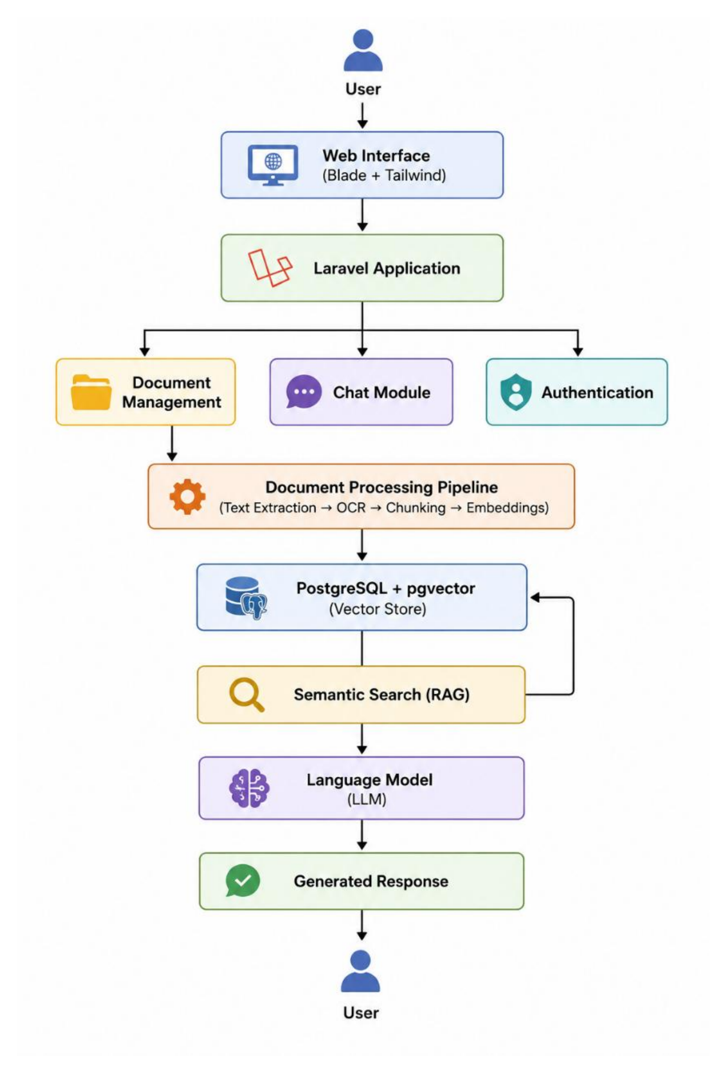
MAIN SLIDE 5
System Architecture
Web interface
Blade and JavaScript
Processing pipeline
OCR and text extraction
Vector storage
PostgreSQL with vectors
Grounded response
Language model with context
AI-powered enterprise document retrieval system
07 / 11
Notes:
This slide shows the high-level architecture extracted directly from the report. The system uses a Laravel web application as the central coordination layer. Users interact through the web interface, documents enter a processing pipeline with text extraction and OCR, chunks are stored with vector representations, and semantic search retrieves relevant context. The response generation step is document-grounded, meaning the answer is based on selected retrieved content rather than unsupported general output.

Slide 8
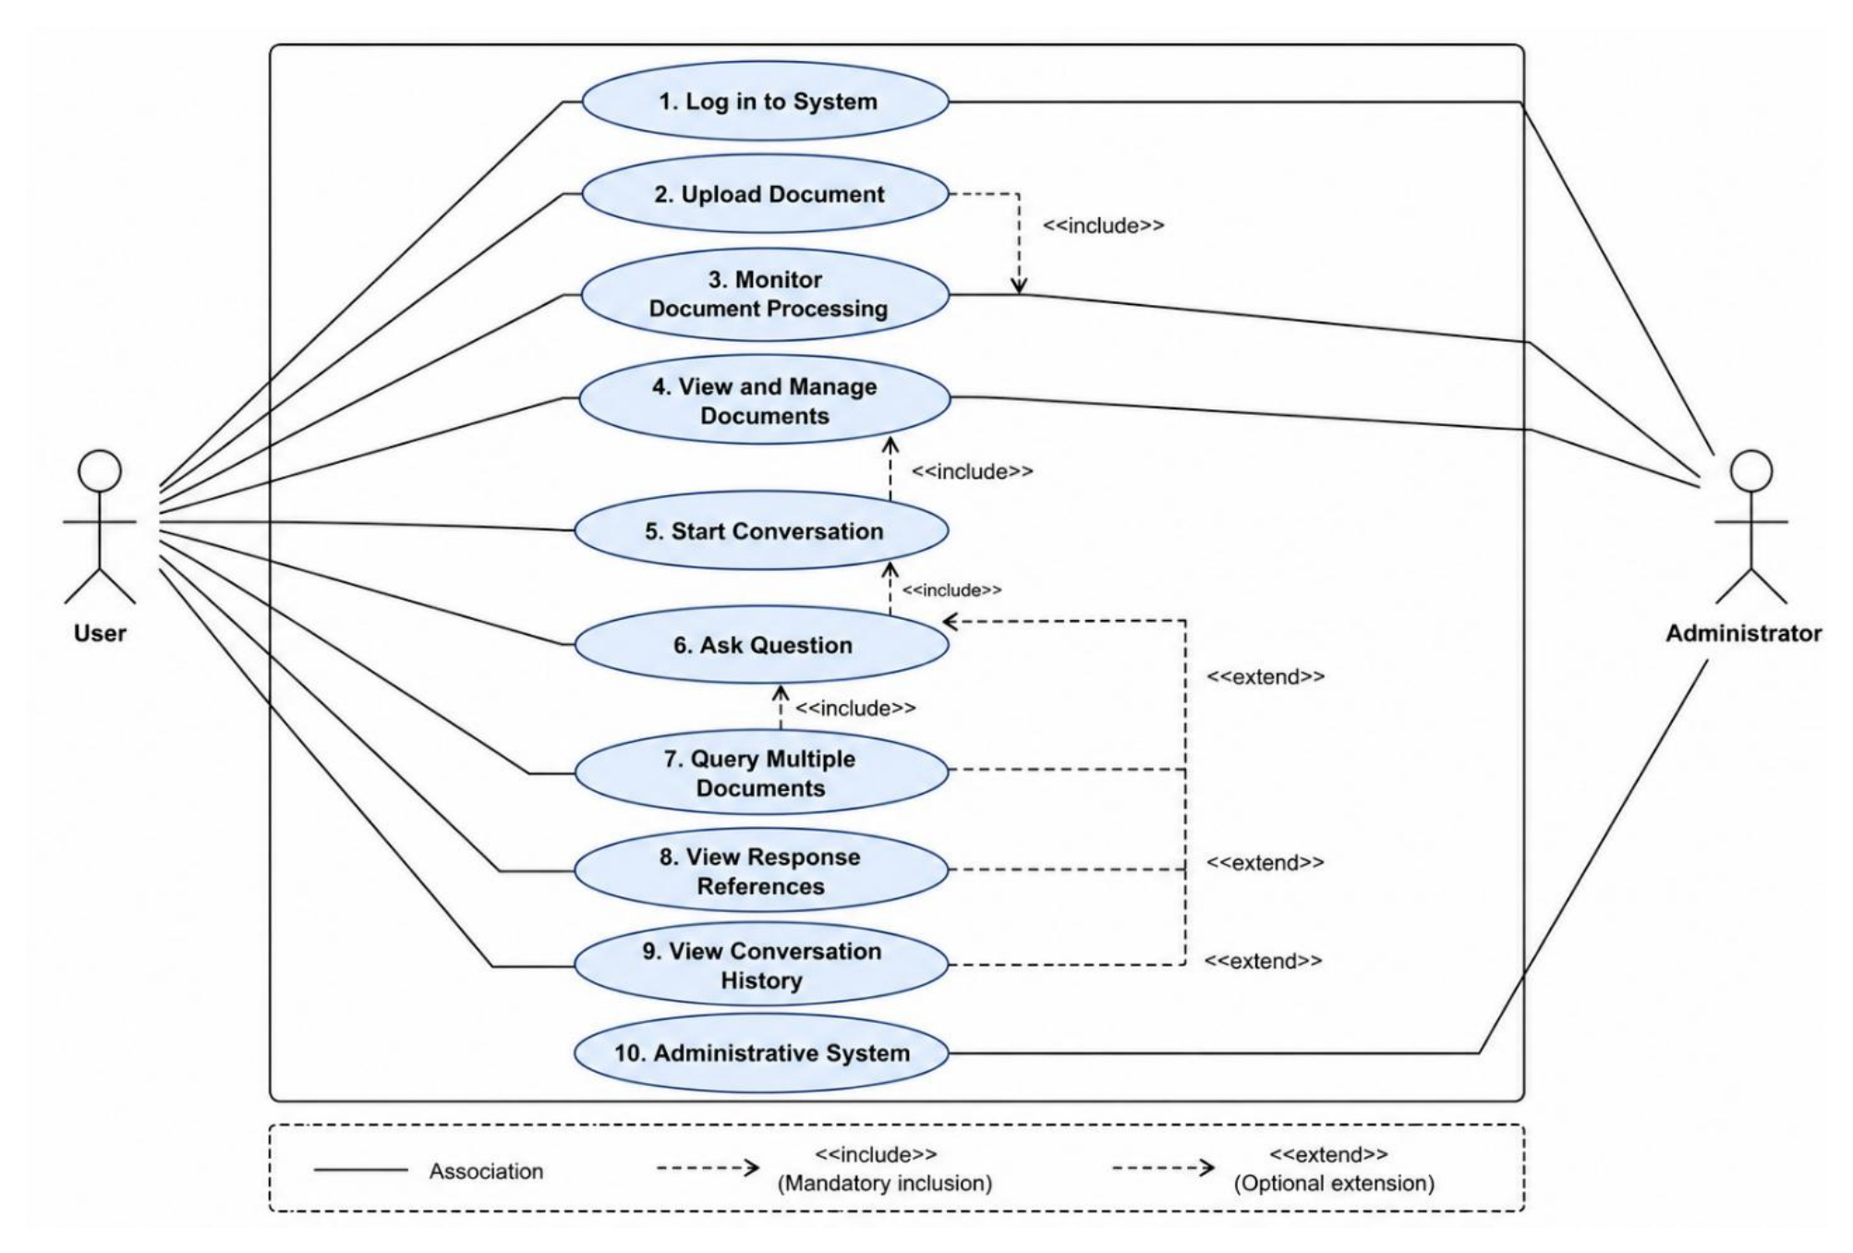
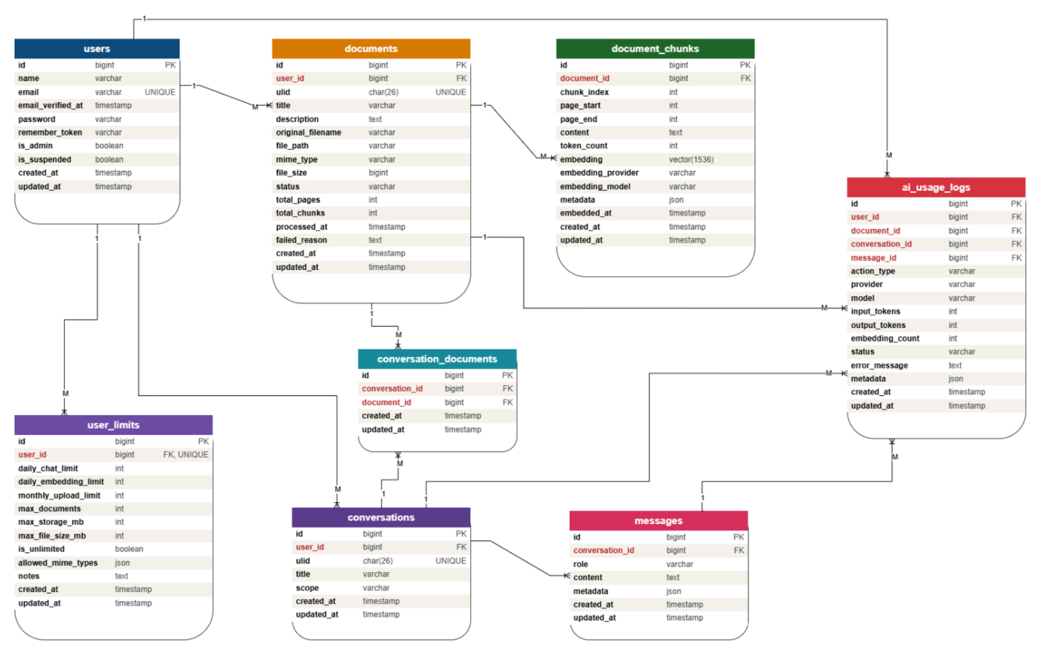
MAIN SLIDE 6
Structure and Models
Use cases
Database model
PHP 8.3
Laravel 12
PostgreSQL
JavaScript
OCR pipeline
AI-powered enterprise document retrieval system
08 / 11
Notes:
The structure slide connects three views of the same system. The use case diagram summarizes the actors and interactions, such as uploading documents, monitoring processing, asking questions, and viewing references. The ER diagram shows how users, documents, chunks, conversations, messages, and usage logs are stored. The implementation stack is Laravel with PHP, PostgreSQL with vector storage, JavaScript for interface behavior, and an OCR-enabled document processing pipeline.

Slide 9
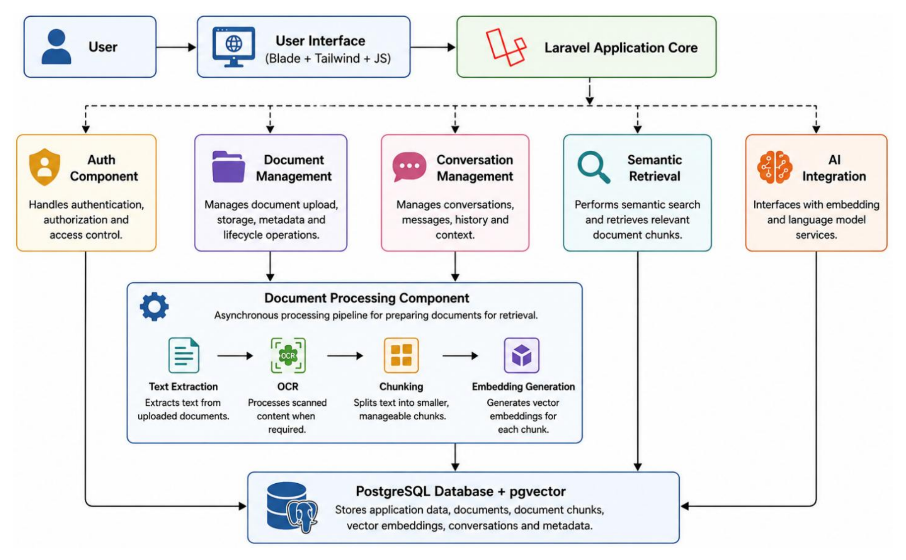
MAIN SLIDE 7
MVC and Hexagonal Architecture
MVC for web application
Laravel separates interface and logic
Hexagonal service boundaries
External services remain replaceable
Queues isolate long tasks
Processing continues in background
RBAC protects enterprise data
Access follows user responsibilities
Component view supports modular reasoning.
Class model kept as supporting design evidence.
AI-powered enterprise document retrieval system
09 / 11
Notes:
The implementation used Laravel's MVC pattern for the web application, while the design also follows hexagonal thinking around external services. The core application should coordinate workflows without being tightly coupled to document extraction, embedding, retrieval, or response generation details. Background queues were chosen for long-running document processing. PostgreSQL with vector storage supports both relational data and semantic retrieval, while role-based access control protects enterprise documents and conversations.

Slide 10
CLOSING
Conclusion
Secure document management
Automated processing pipeline
Semantic document retrieval
Grounded response generation
Extensible enterprise architecture
The project translated enterprise knowledge needs
into a maintainable software architecture.
AI-powered enterprise document retrieval system
10 / 11
Notes:
To conclude, the project delivered a complete specification and design foundation for an AI-assisted enterprise document retrieval system. The work combined secure document management, automated processing, semantic retrieval, conversation management, and document-grounded response generation. From a software engineering perspective, the most important outcome is the maintainable structure: clear requirements, modular architecture, defined data relationships, and design decisions that support future extension without exposing unnecessary implementation details.

Slide 11
Questions?
Thank you for your attention
Enterprise RAG system | Master's internship presentation
AI-powered enterprise document retrieval system
11 / 11
Notes:
This final slide is intended to leave space for discussion. I would invite questions about the requirements, architecture, model design, or implementation decisions. If asked about details, I would keep the explanation at an appropriate engineering level: Laravel-based MVC application, background processing, PostgreSQL with vector storage, semantic search, conversation management, and document-grounded responses. I would avoid vendor-specific or confidential implementation details and focus on design reasoning.

